Slide 1

Crime Rate Prediction Using ML and Spark
Submitted by
Vinay Sonkar(220943025058)
Guided by: Shreya Joshi(220943025040)
Tushar Kute Sir Shubham Waghmare(220943025044)
Trupti Joshi Ma’am Nishant Deshpande(220943025021)

Slide 2
Overview:
Introduction
Problem Statement
Flowchart to build model
Data Pre-Processing
Methodology
Machine Learning Algorithms
Data Visualization & Representation
Conclusion
Future Scope
References

Slide 3
Introduction
The Chicago crime dataset contains various attributes such as the type of crime, location, date and time, and whether an arrest was made or not. This dataset is an excellent source of information for building predictive models that can help law enforcement agencies to identify high-risk areas and prevent crime.
The main goal of this project is to build a machine learning model that can accurately predict whether an arrest was made or not for a given crime incident in Chicago.
To achieve this, we will first explore the dataset, preprocess the data, and engineer new features that could improve the predictive power of the model. We will then train several machine learning models on the preprocessed dataset and select the best performing model based on the evaluation metrics.
The project has several practical applications, including aiding law enforcement agencies to improve their crime prevention strategies and helping policymakers to make informed decisions about resource allocation. The success of the project will depend on the accuracy and generalizability of the machine learning model to new data, which we will evaluate using appropriate performance metrics.

Slide 4
DATASET INFORMATION
Data source: This dataset is publicly available for anyone to use under the following terms provided by the Dataset Source —https://data.cityofchicago.org
Data content: Primary Type , Block , Description, Location Description, Location.
Data understanding : Available variables Relationships

Slide 5
Problem Statement
To build a machine learning model that can learn patterns from historical data on crime incidents in Chicago and use those patterns to accurately predict whether an arrest was made or not in future crime incidents.

Slide 6
Overview of Technology Used
• Python
• Spark
• Machine Learning
• Tableau

Slide 7





Architecture
Raw Kaggle Dataset
ML Classifier
Pre-processing
Pre-processing on
Notebook
Predictions
Fig.: System Architecture for Predicting Chicago_Crime_Dataset (2012-2017) using Machine Learning
7

Slide 8
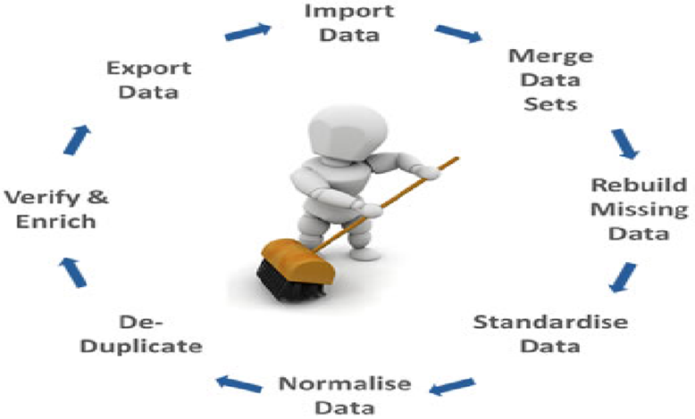
Data Pre-Processing
1: Check and remove nulls
2: Label encoding
3. One hot encoding
4. Cleaning outliers
6. Data scaling
5. Visualization

Slide 9
Methodology
Data Used :
Chicago_Crime_Datasett(2012-2017)
Dumping the Data :
We fetched data from API of Kaggle
Data Pre-processing :
Cleaned & transformed the data in the format we can access it
Machine Learning Model Used :
Decision Tree, Random Forest, Logistic Regression
Visualizing the Data :
Visualised the data using Tableau
Fig.: Methodology of Chicago_Crime_Dataset (2012-2017)
12/03/2023

Slide 10
ML Algorithms used
K-Nearest Neighbour
Logistic Regression
Random Forest
MODELS | ACURACCY | F1 Score
K-NN | 0.30529 | 0.2978
Logistic Regression | 0.72187
Random Forest | 0.86094 | o.849867

Slide 11
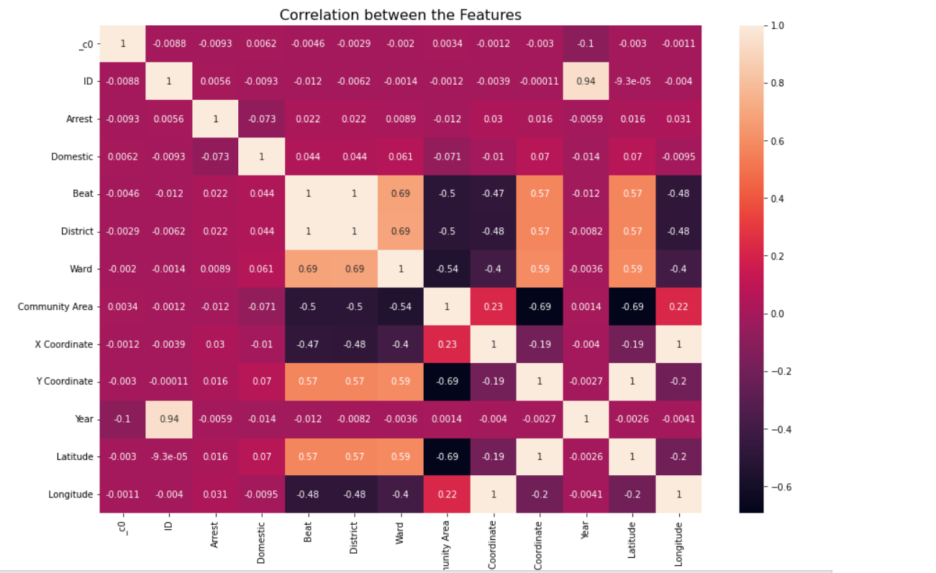
CORRELATION BETWEEN FEATURES

Slide 12
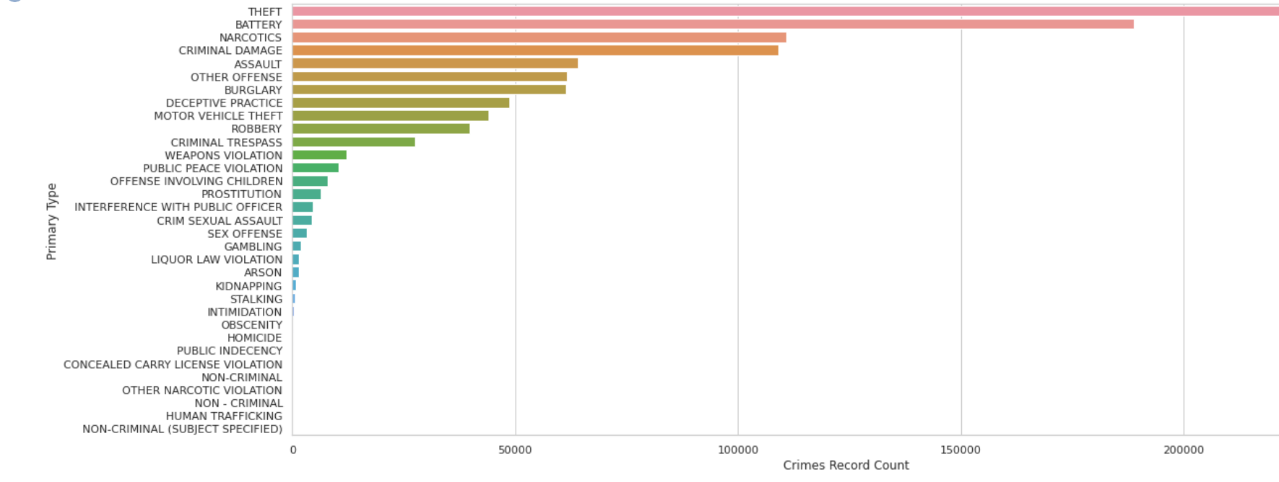
Crime As Per Count

Slide 13
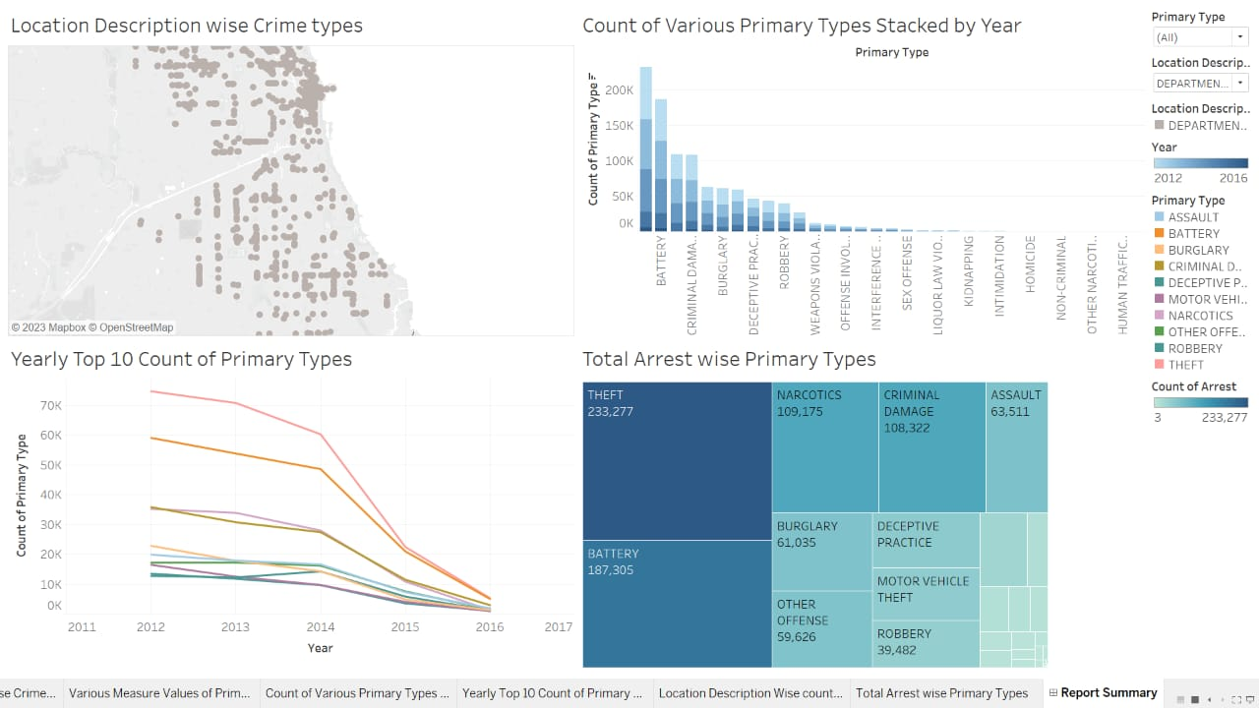
Data Visualization and Representation

Slide 14
Conclusion
Crime prediction analysis on the Chicago dataset has shown promising results in forecasting criminal activities in different regions of the city.
By applying various machine learning algorithms, such as random forest, Logistic regression and Random Forest, we can be able to accurately predict the likelihood of crime occurrence in specific areas.
Moreover, the analysis has also provided insights into the factors that contribute to crime, including time of the day, location description etc.

Slide 15
Future scope
In the future, crime prediction analysis on the Chicago dataset can be further improved by incorporating additional data sources, such as social media feeds and CCTV footage.
This can provide more detailed insights into the patterns of criminal activities and help law enforcement agencies to take proactive measures to prevent crime.
Furthermore, the use of advanced deep learning techniques, such as recurrent neural networks and convolutional neural networks, can also help to improve the accuracy of crime prediction models.
Finally, the deployment of real-time crime prediction systems can also help to alert law enforcement agencies and civilians about potential criminal activities, thereby improving public safety in the city.

Slide 16
References
1. https://www.kaggle.com
2. https://colab.research.google.com/
3. https://spark.apache.org/docs/latest/api/python/
4. https://data.gov/
5. https://stackoverflow.com/questions/
6. https://www.statology.org/machine-learning-tutorials/

Slide 17
THANKYOU!!

